Slide 1
SFL ONLİNE
Ekin Naz Eren
Tolga Şıvgın

Slide 2
Our work so far…
- Use Case Diagram
- Class Diagram
- ER Diagram

Slide 3
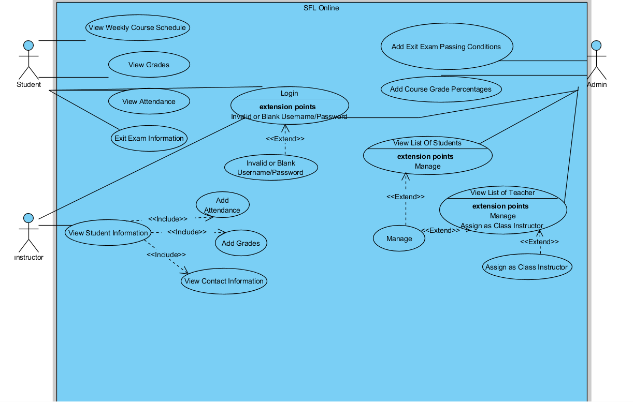
Use Case Diagram

Slide 4
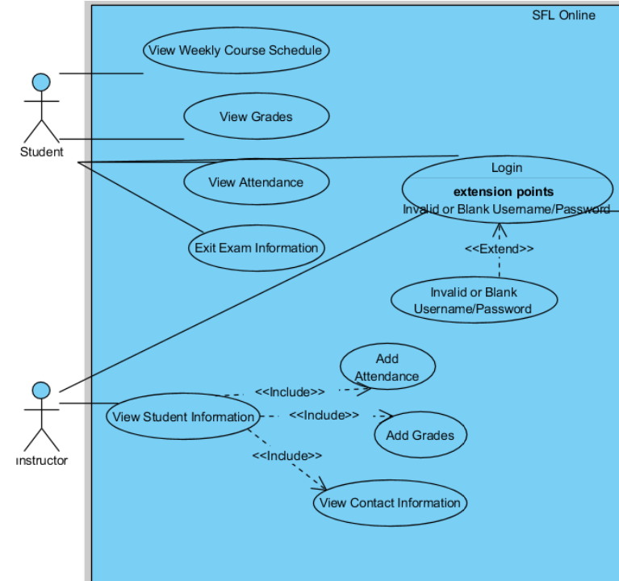

Slide 5
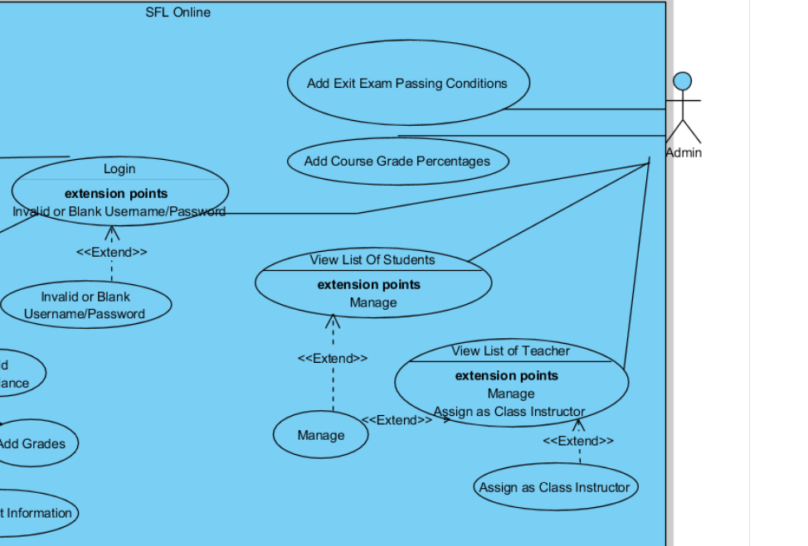

Slide 6
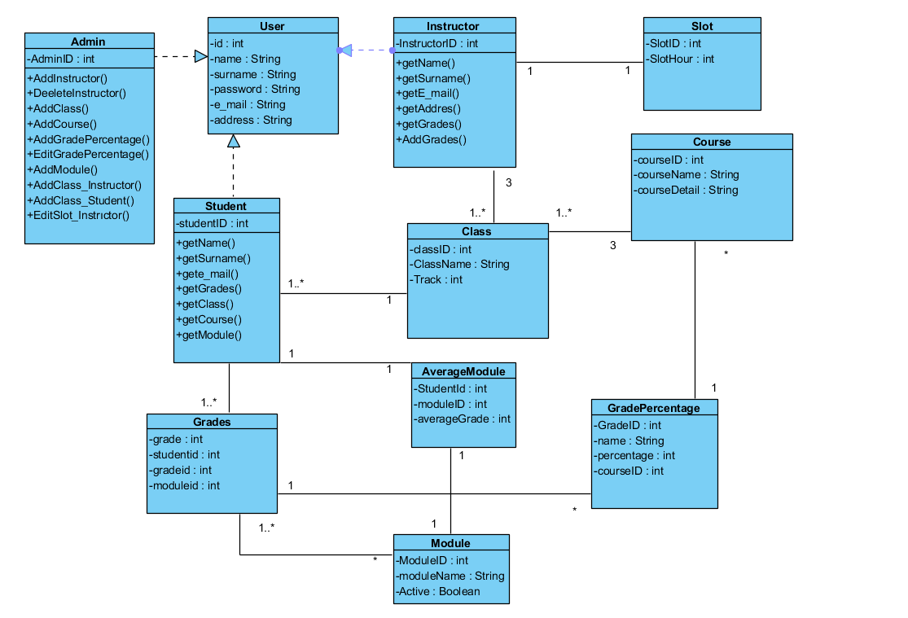
Class Diagram

Slide 7
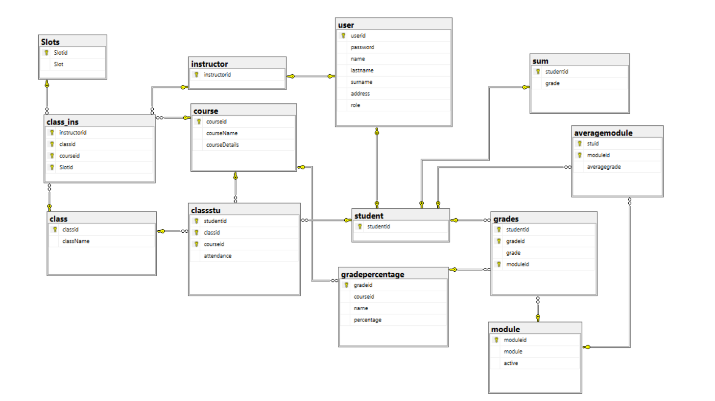
ER Diagram

Slide 8
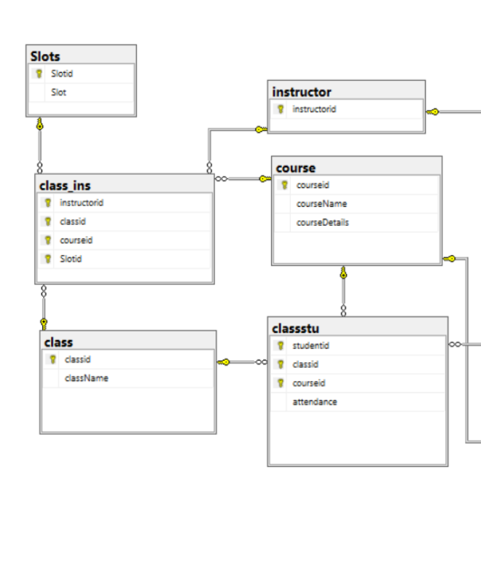

Slide 9
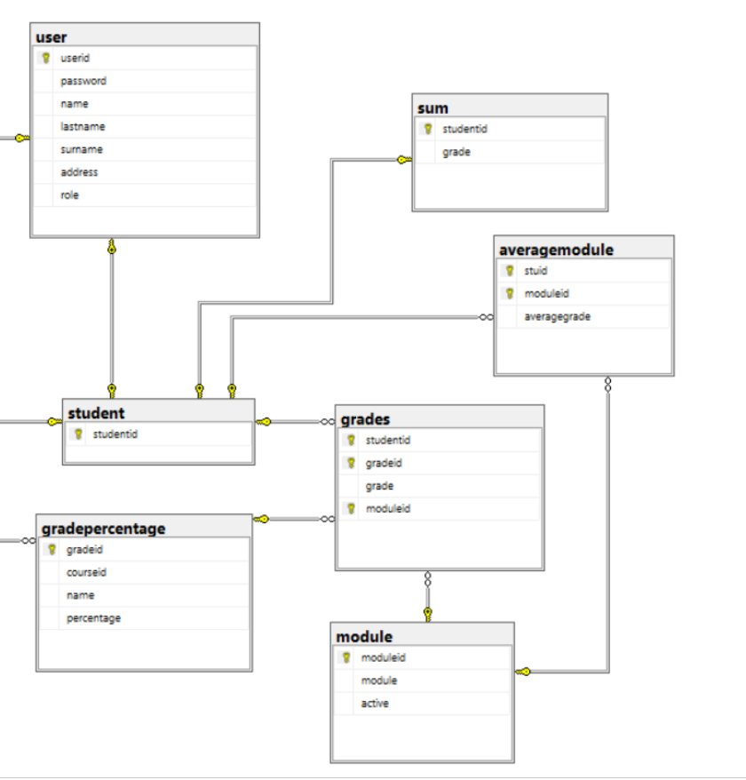

Slide 10
